Slide 1
Multiple Wavetable Synthesis
Wavetable Crossfading
Wavestacking

Slide 2
Wavetable Crossfading

Slide 3
Wavetable Crossfading

Slide 4
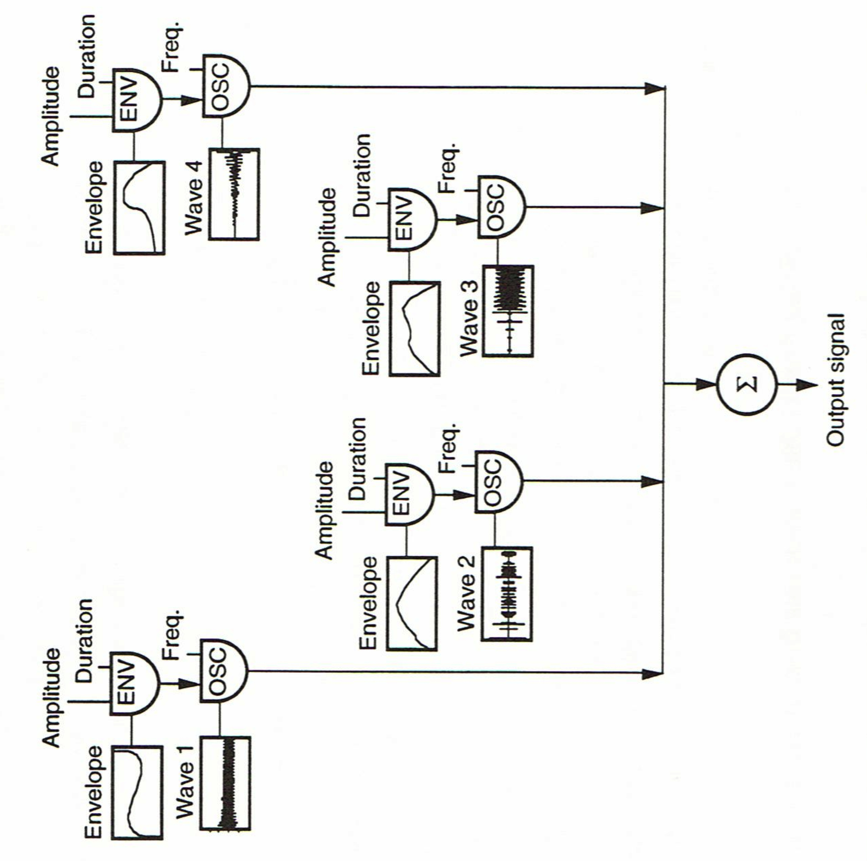
Wavestacking

Slide 5
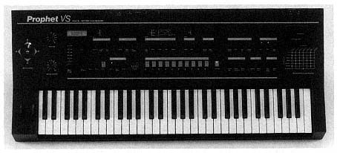
Wavestacking

Slide 6
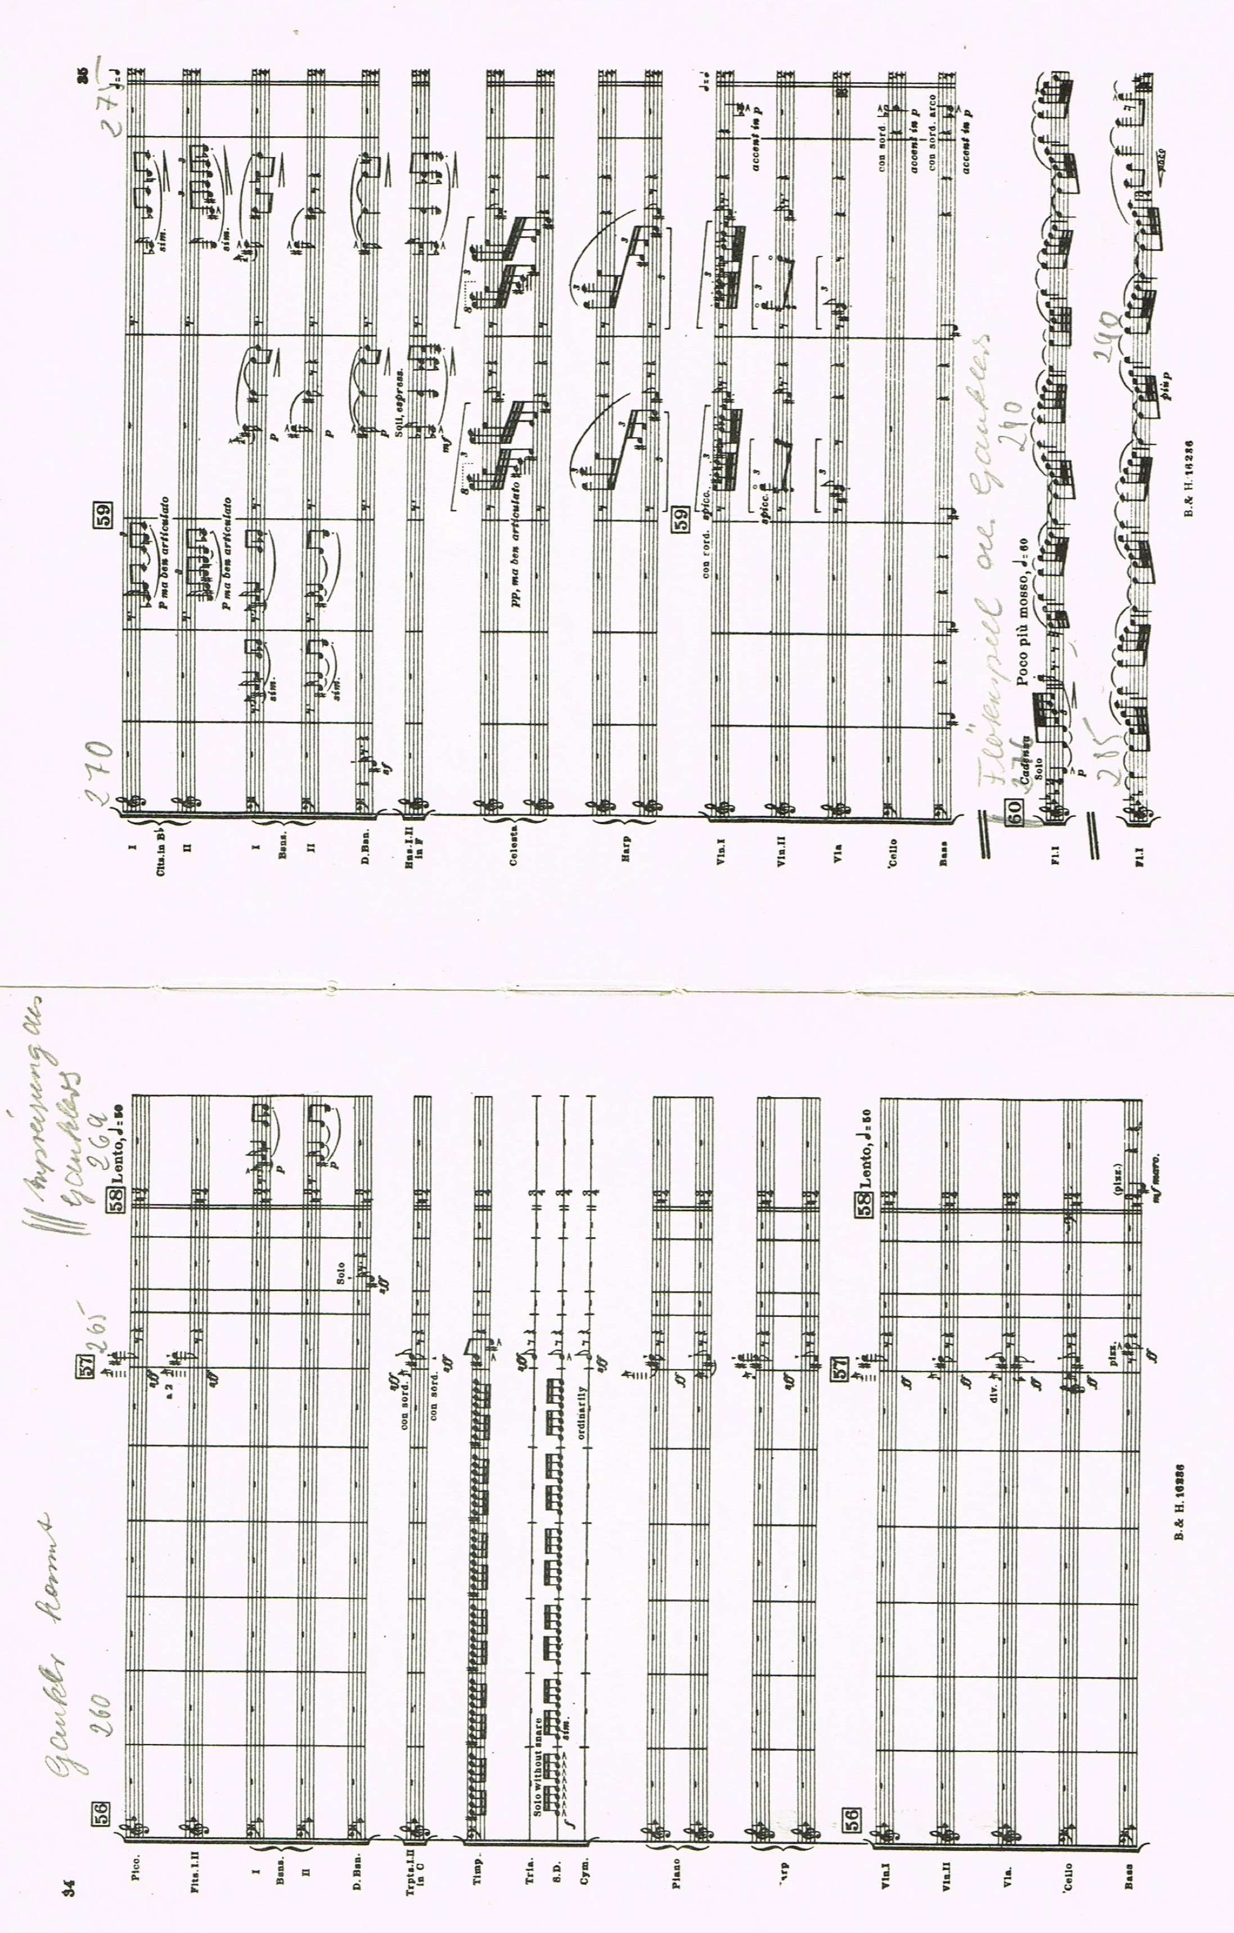

Igor Stravinsky, Petrouchka (1911)

Slide 7
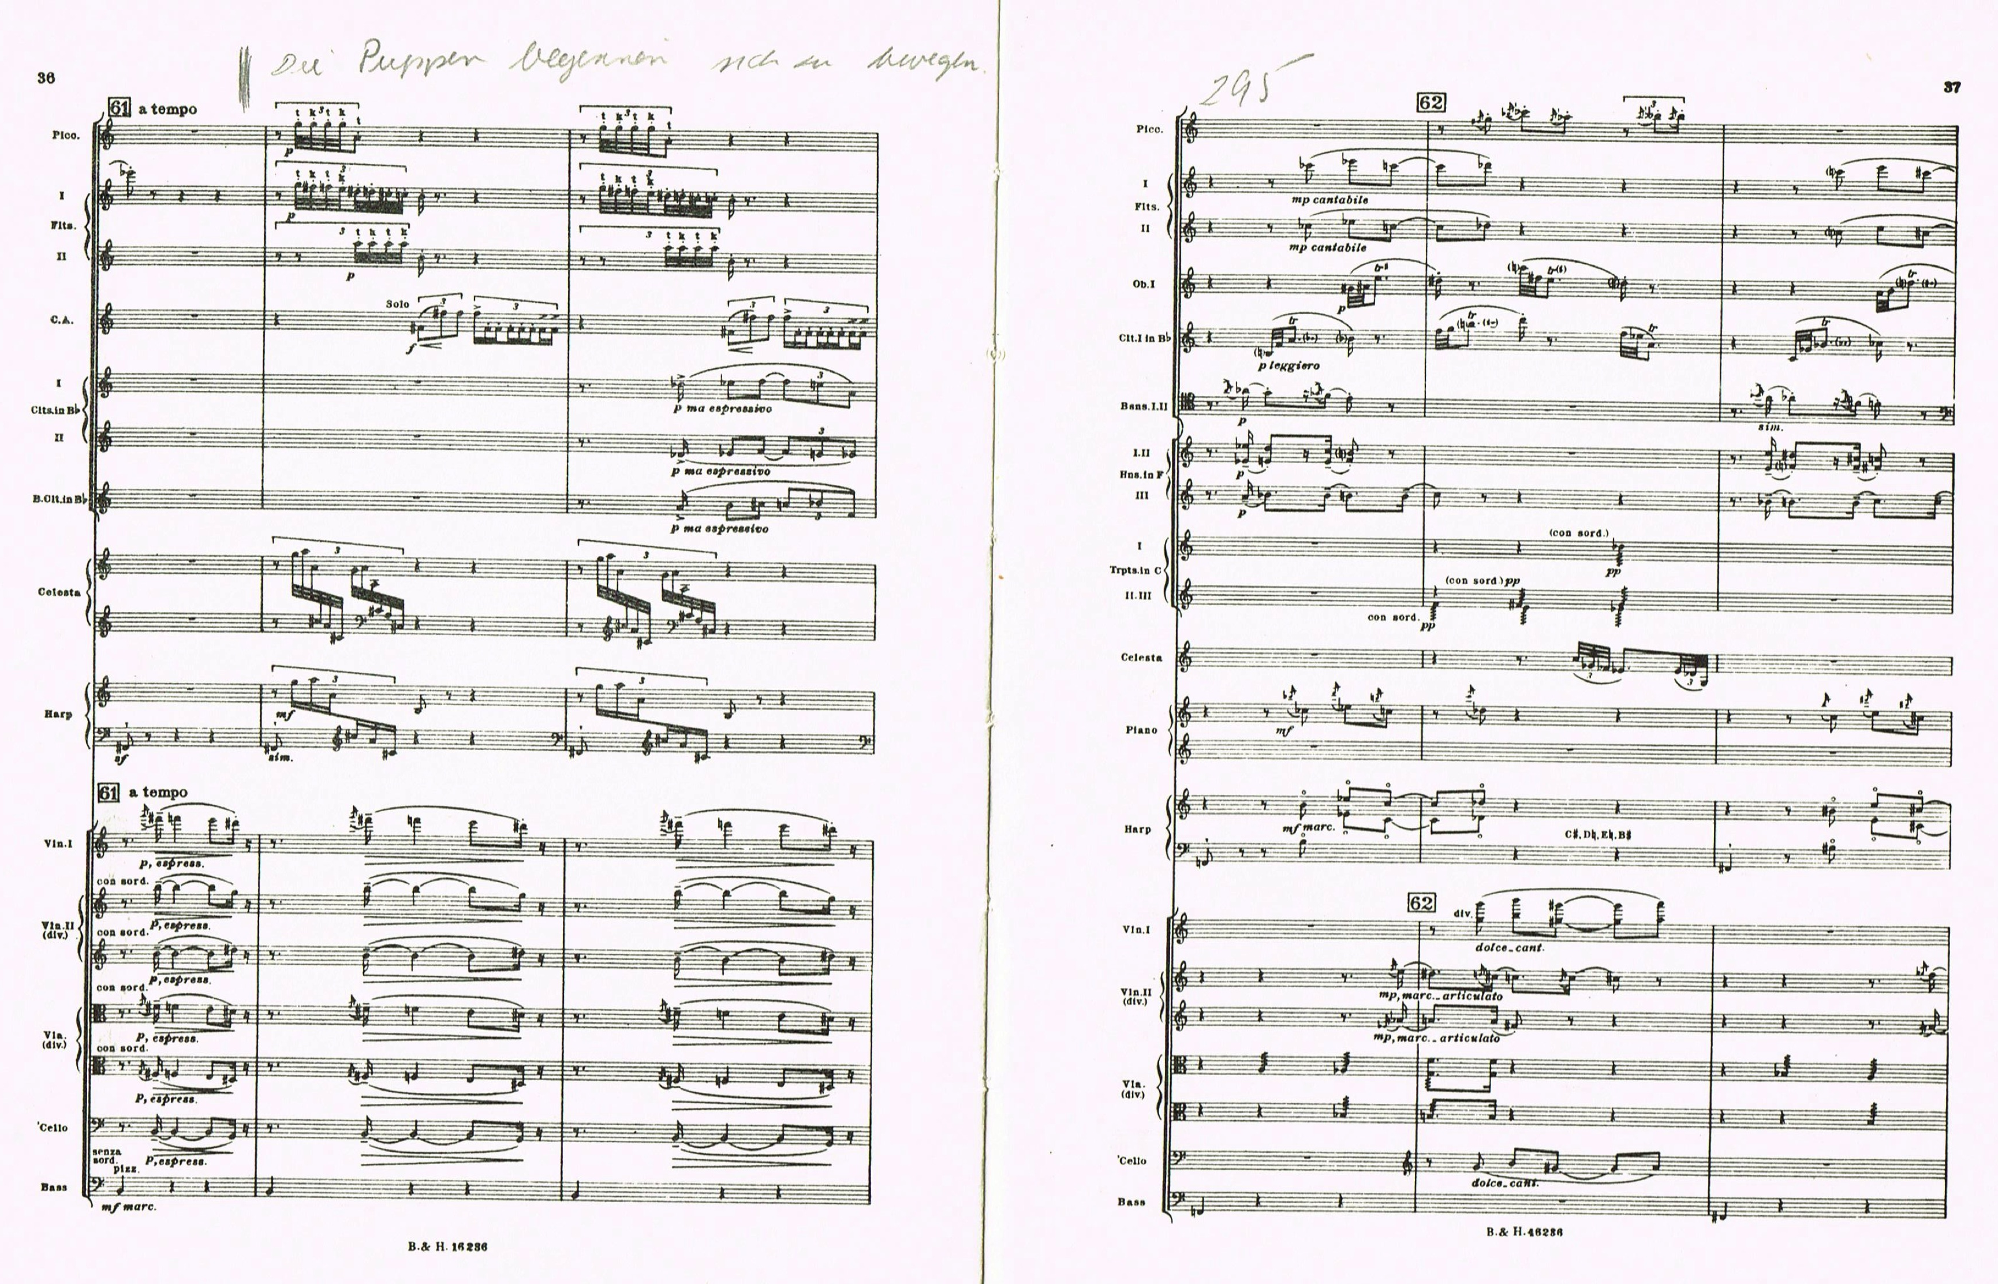
Igor Stravinsky, Petrouchka (1911)

Slide 8

Arnold Schönberg, Fünf Orchesterstücke op. 16 / III. Farben (1909)

Slide 9
György Ligeti, Atmosphères (1961) - Filter

Slide 10
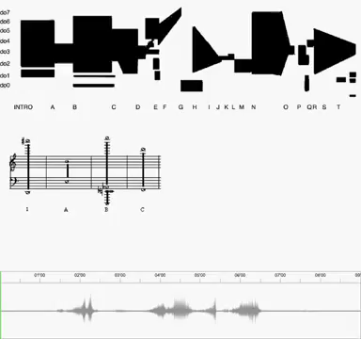
György Ligeti, Atmosphères (1961)

